Slide 1
CLASSIFICATION – NAIVE BAYES
Nghia Tran 21th June

Slide 2
Agenda
Bayes theorem
Naive Bayes classifier (NBF)
Common distribution functions in NBF
Gaussian naive Bayes
Multinomial naive Bayes
Bernoulli naive Bayes
Summary
Demo with Python

Slide 3
Bayes theorem

Slide 4

Bayes theorem
Wrench
Example from @SuperDataScience

Slide 5
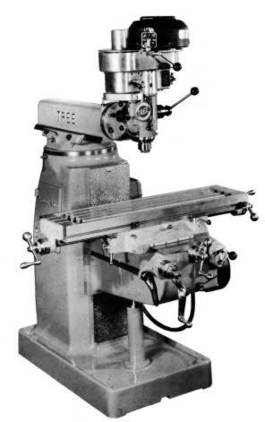
Bayes theorem
m1
m2
Example from @SuperDataScience

Slide 6

Bayes theorem
Example from @SuperDataScience

Slide 7
Bayes theorem
What’s the probability ?
m2
Example from @SuperDataScience

Slide 8
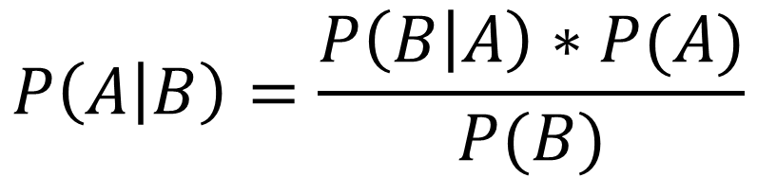
Bayes theorem
$$P\left(A | B\right)=\frac{P\left(B | A\right)∗P(A)}{P(B)}$$
Example from @SuperDataScience

Slide 9
Bayes theorem
Mach1: 30 wrenches / hour
Mach2: 20 wrenches / hour
Out of all produced parts, we can see that 1% are defective:
50% came from mach1
50% came from mach2
Question:
What is the probability that a part produced by mach2 is defective ?
→P(Mach1) = 30/50 = 0.6
P(Mach2) = 20/50 = 0.4
P(Defect) = 1%
P(Mach1 | Defect) = 50%
P(Mach2 | Defect) = 50%
→P(Defect | Mach2) = ?
Example from @SuperDataScience

Slide 10



Bayes theorem
Mach1: 30 wrenches / hours
Mach2: 20 wrenches / hours
Out of all produced parts, we can see that 1% are defective:
50% came from mach1
50% came from mach2
Question:
What is the probability that a part produced by mach2 is defective ?
→P(Mach1) = 30/50 = 0.6
P(Mach2) = 20/50 = 0.4
P(Defect) = 1%
P(Mach1 | Defect) = 50%
P(Mach2 | Defect) = 50%
→P(Defect | Mach2) = ?
$$P\left(Defect | Mach2\right)=\frac{P\left(Mach2 \right| Defect)∗P(Defect)}{P(Mach2)}$$
$$=\frac{ 0.5 ∗ 0.01 }{0.4}$$
$$=0.0125=1.25\%$$
Example from @SuperDataScience

Slide 11



Bayes theorem
Mach1: 30 wrenches / hours
Mach2: 20 wrenches / hours
Out of all produced parts, we can see that 1% are defective:
50% came from mach1
50% came from mach2
Question:
What is the probability that a part produced by mach1 is defective ?
→P(Mach1) = 30/50 = 0.6
P(Mach2) = 20/50 = 0.4
P(Defect) = 1%
P(Mach1 | Defect) = 50%
P(Mach2 | Defect) = 50%
→P(Defect | Mach1) = ?
$$P\left(Defect | Mach1\right)=\frac{P\left(Mach1 \right| Defect)∗P(Defect)}{P(Mach1)}$$
$$=\frac{ 0.5 ∗ 0.01 }{0.6}$$
$$=0.0083=0.83\%$$
Example from @SuperDataScience

Slide 12
Naive Bayes classifier (NBF)

Slide 13
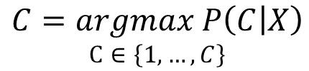
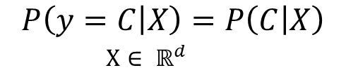
Naive Bayes classifier
$$P\left(y=C | X\right)=P\left(C | X\right)$$
$X∈ ℝ^{d}$
$$C=argmax P\left(C | X\right)$$
$$C∈\left\{1,…,C\right\}$$
Bayes theorem :
$$C=argmax P\left(C | X\right)=argmax\frac{P\left(X | C\right)P(C)}{P(X)}=argmax P\left(X | C\right)P(C)$$

Slide 14



Naive Bayes classifier
$$C=argmax P\left(X | C\right)P(C)$$
$$P\left(C\right)= \frac{Number of Data belonging to class C}{Number Observations}⇒Maximum likelihood estimate(MLE)$$
$$P\left(X|C\right)= ?$$
$$⇒Naive Bayes$$

Slide 15


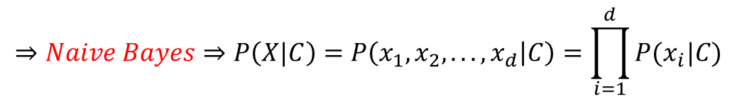



Naive Bayes classifier
$$x_{2}=Salary$$
Drives
Walks
New data point
$$x_{1}=Age$$
$$P\left(X|C\right)= ?$$
$X∈ ℝ^{d}$
$$⇒Independent assumption$$
$$⇒Naive Bayes⇒P\left(X|C\right)=P\left(x_{1}, x_{2},. . .,x_{d} | C\right)=\prod_{i=1}^{d}{P(x_{i}|C)}$$

Slide 16
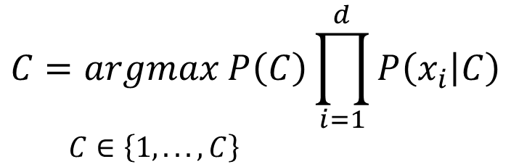
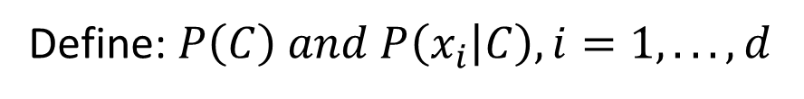
Naive Bayes classifier
SUMMARY
At training step:
Define: $P\left(C\right) and P\left(x_{i} | C\right), i=1,. . .,d$
At testing step:
Label of new data point will be defined by:
$$C=argmax P\left(C\right)\prod_{i=1}^{d}{P\left(x_{i} | C\right)}$$
$C∈\left\{1,. . .,C\right\}$

Slide 17
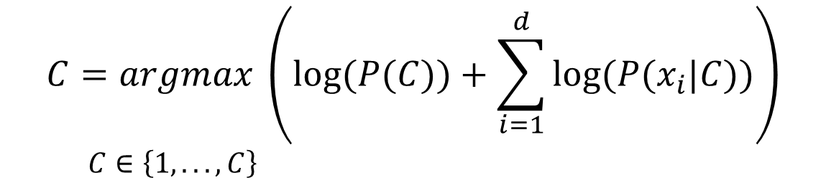
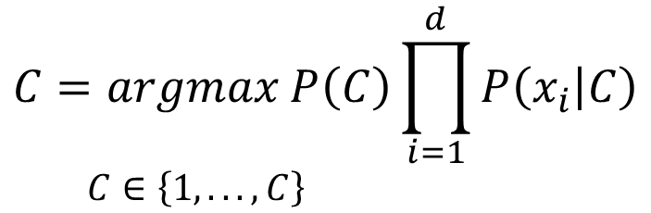
Naive Bayes classifier
$$C=argmax P\left(C\right)\prod_{i=1}^{d}{P\left(x_{i} | C\right)}$$
$C∈\left\{1,. . .,C\right\}$
Problem: If “d” is large and probabilities are small, “C” will be very small
=> Apply “log” to right side:
$$C=argmax \left(log⁡(P(C))+\sum_{i=1}^{d}{log⁡(P(x_{i}|C))}\right)$$
$C∈\left\{1,. . .,C\right\}$

Slide 18
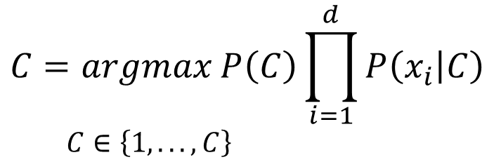
Naive Bayes classifier
MLE
$$C=argmax P\left(C\right)\prod_{i=1}^{d}{P\left(x_{i} | C\right)}$$
$C∈\left\{1,. . .,C\right\}$
depends on the type of data

Slide 19
Common distribution functions in NBF

Slide 20
Common distribution functions in NBF
Gaussian naive Bayes
Use if data are continuous random variable
Multinomial naive Bayes
Use if data are discrete random variable, text classification
Bernoulli naive Bayes
Use if data are discrete random variable, text classification

Slide 21

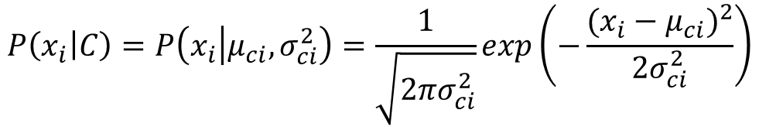
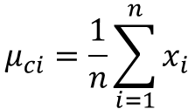
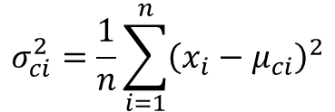
Gaussian naive Bayes
$$μ_{ci}=\frac{1}{n}\sum_{i=1}^{n}{x_{i}}$$
expectation
C$reate parameter sets: θ=\{μ_{ci}, σ_{ci}^{2}\}$
$$σ_{ci}^{2}=\frac{1}{n}\sum_{i=1}^{n}{{\left(x_{i}−μ_{ci}\right)}^{2}}$$
variance
$$P\left(x_{i} | C\right)=P\left(x_{i} | μ_{ci},σ_{ci}^{2}\right)=\frac{1}{\sqrt{2πσ_{ci}^{2}}}exp\left(−\frac{{(x_{i}−μ_{ci})}^{2}}{2σ_{ci}^{2}}\right)$$

Slide 22


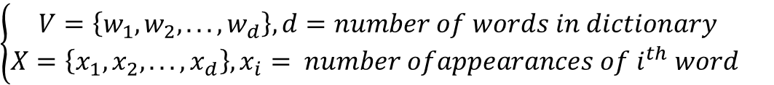
Multinomial naive Bayes
Apply “Bag of words” idea:
$$\left\{\begin{aligned}V=\left\{w_{1},w_{2}, . . .,w_{d}\right\}, d=number of words in dictionary \\ {X=\left\{x_{1},x_{2},. ..,x_{d}\right\},x}_{i}= {number ofappearances of i}^{th} word \end{aligned}\right.$$
standardized data
$${⇒λ}_{ci}=P\left(x_{i}|C\right)=\frac{N_{ci}}{N_{c}}$$
$N_{ci}$: total number of $i^{th}$ words that appearing in class C
$N_{ci}$: total number of words that appearing in class C
$$⇒N_{c}=\sum_{i=1}^{d}{N_{ci}} \& \sum_{i=1}^{d}{λ_{ci}=1}$$

Slide 23
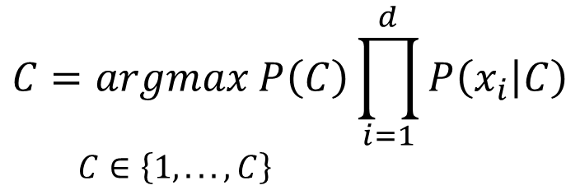
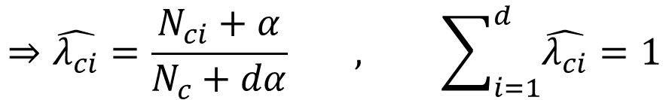
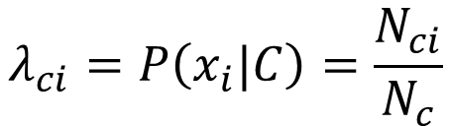
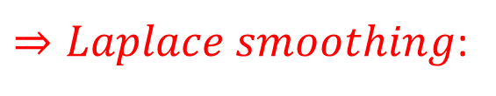
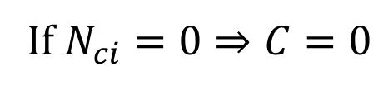
Multinomial naive Bayes
Remind:
$$C=argmax P\left(C\right)\prod_{i=1}^{d}{P\left(x_{i} | C\right)}$$
$C∈\left\{1,. . .,C\right\}$
$$λ_{ci}=P\left(x_{i}|C\right)=\frac{N_{ci}}{N_{c}}$$
If $N_{ci}=0⇒C=0$
$⇒Laplace smoothing$:
$$⇒\hat{λ_{ci}}=\frac{N_{ci}+α}{N_{c}+dα} , \sum_{i=1}^{d}{\hat{λ_{ci}}=1}$$
$$⇒Create parameter sets: \hat{λ_{ci}}=\{\hat{λ_{ci}},…,\hat{λ_{cd}}\}$$
Notes:
https://www.quora.com/Could-someone-explain-Laplacian-smoothing-or-1-up-smoothing

Slide 24
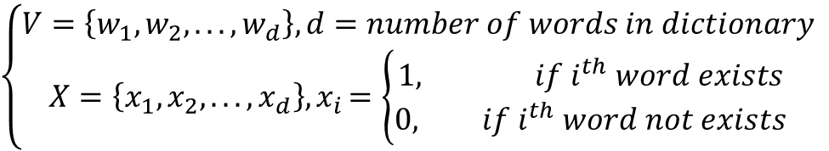

Bernoulli naive Bayes
Apply “Bag of words” idea:
$$\left\{\begin{aligned}V=\left\{w_{1},w_{2}, . . .,w_{d}\right\}, d=number of words in dictionary \\ X=\left\{x_{1},x_{2},. ..,x_{d}\right\}{, x}_{i}=\left\{\begin{aligned}1, {if i}^{th} word exists \\ &0, {if i}^{th} word not exists\end{aligned}\right.\end{aligned}\right.$$
standardized data
$$Create parameter sets:P\left(i | C\right)$$
$$⇒P\left(x_{i} | C\right)=P\left(i | C\right)x_{i}+(1−P(i|C))(1−x_{i})$$

Slide 25
Summary

Slide 26
Summary
NBC is commonly used in text classification
Quick training and testing
If independence assumption is satisfied, result is better than SVM
Use for continuous random variable (Gaussian) and discrete random variable (Multinomial, Bernoulli)

Slide 27
Demo with Python

Slide 28
Evaluation Methods
https://machinelearningcoban.com/2017/08/31/evaluation/

Slide 29
References
Ứng dụng thuật toán Naive Bayes trong giải quyết bài toán chuẩn đoán bệnh tiểu đường
https://viblo.asia/p/ung-dung-thuat-toan-naive-bayes-trong-giai-quyet-bai-toan-chuan-doan-benh-tieu-duong-eW65GYejZDO
Naïve Bayes classifier https://machinelearningcoban.com
Machine Learning A-Z
https://www.superdatascience.com/machine-learning

